Slide 1
Machine learning algorithm for employee selection
Metin Akif Zehir - 21290608
Bilal Emre Durmuş - 22290753

Slide 2
Preprocessing
When we chose the dataset, we used some filters for data preprocessing.
We use SMOTE filter for more balanced dataset.
After applying SMOTE filter, we obtain 1453 artificial instances which have target values are equal to 1.
Finally, we have balanced dataset.

Slide 3
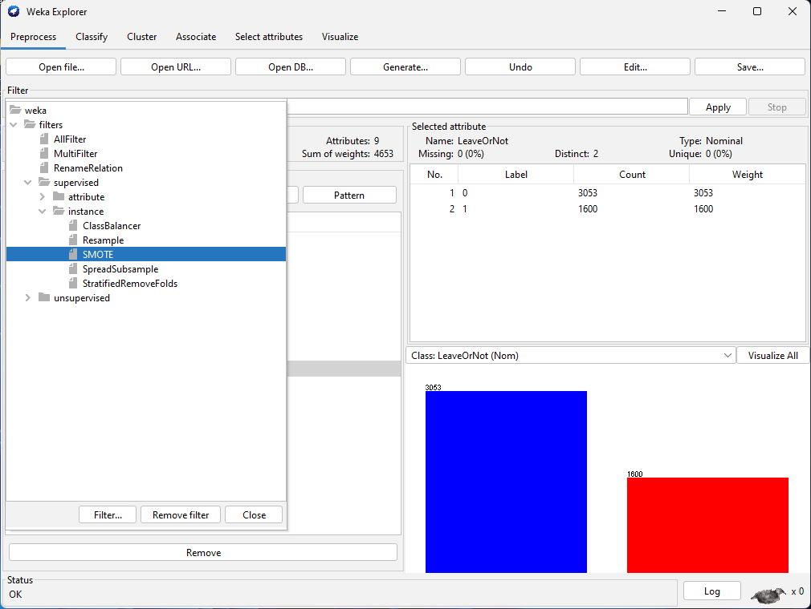

Slide 4
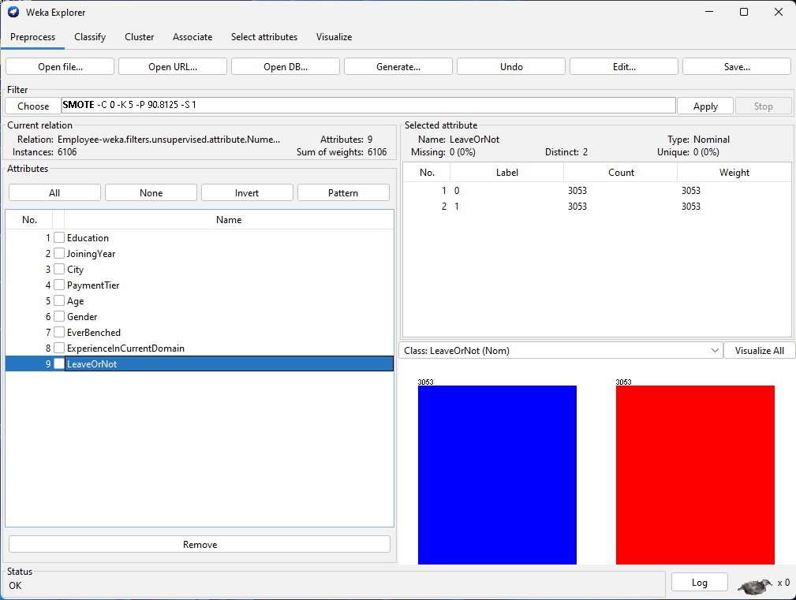

Slide 5
Splitting the dataset
After SMOTE filter, we split the instances for training, validation and testing.
For training > 60% of the instances
For validation > 20% of the instances
For testing > 20% of the instances

Slide 6
CLASIFICATION
We chose kNN (IBk) classification method.
Validation Step
We used training set and validation set.
We chose 1 for k`s value.

Slide 7
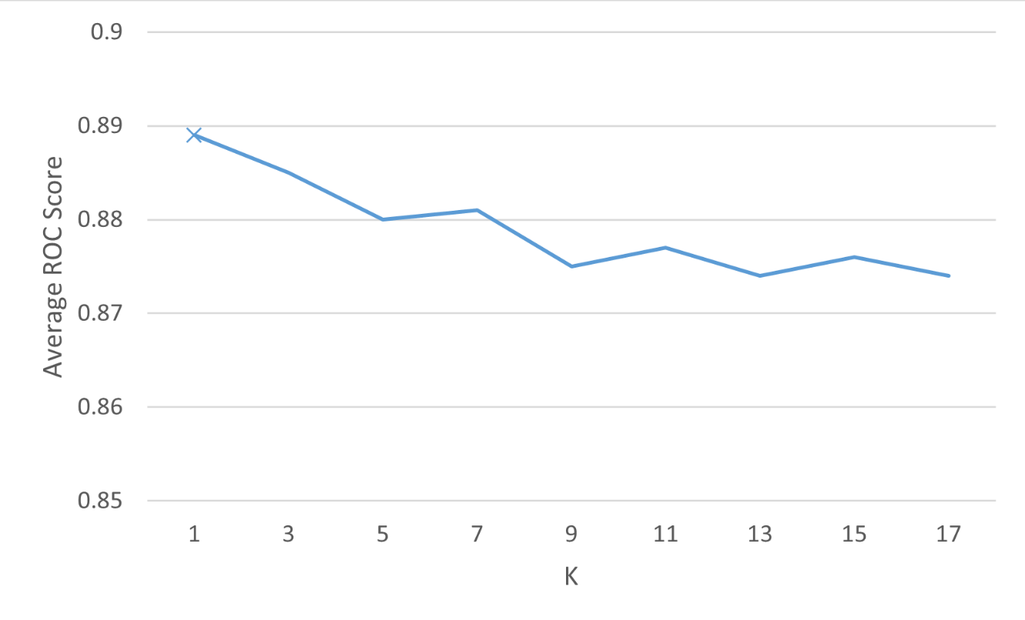

Slide 8
CLASIFICATION
Testing Step
We used training set + validation set as a training set.
We also used the test set.
We chose 1 for k`s value.
Then we apply kNN classification.

Slide 9
